Slide 1


Data Interpretation

Slide 2

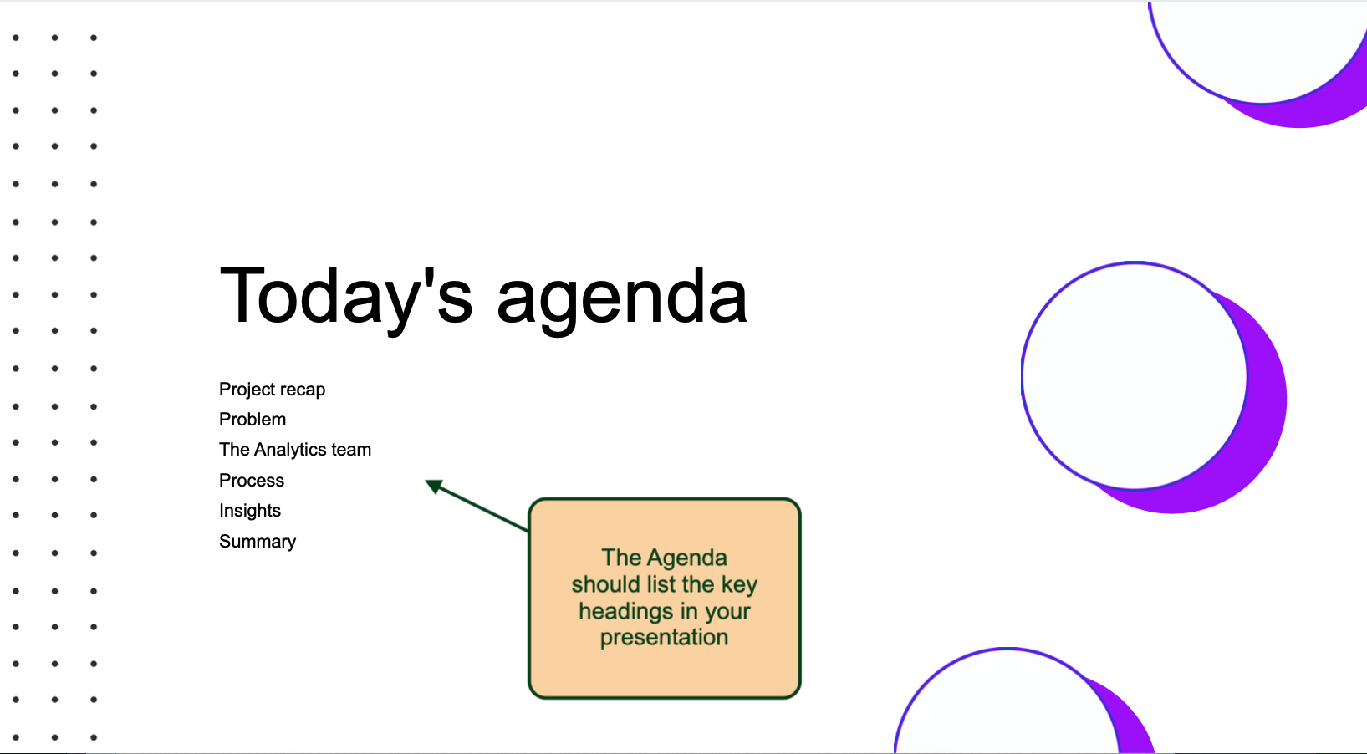

Today's agenda
Project recap
Problem
The Analytics team
Process
Insights
Summary

Slide 3
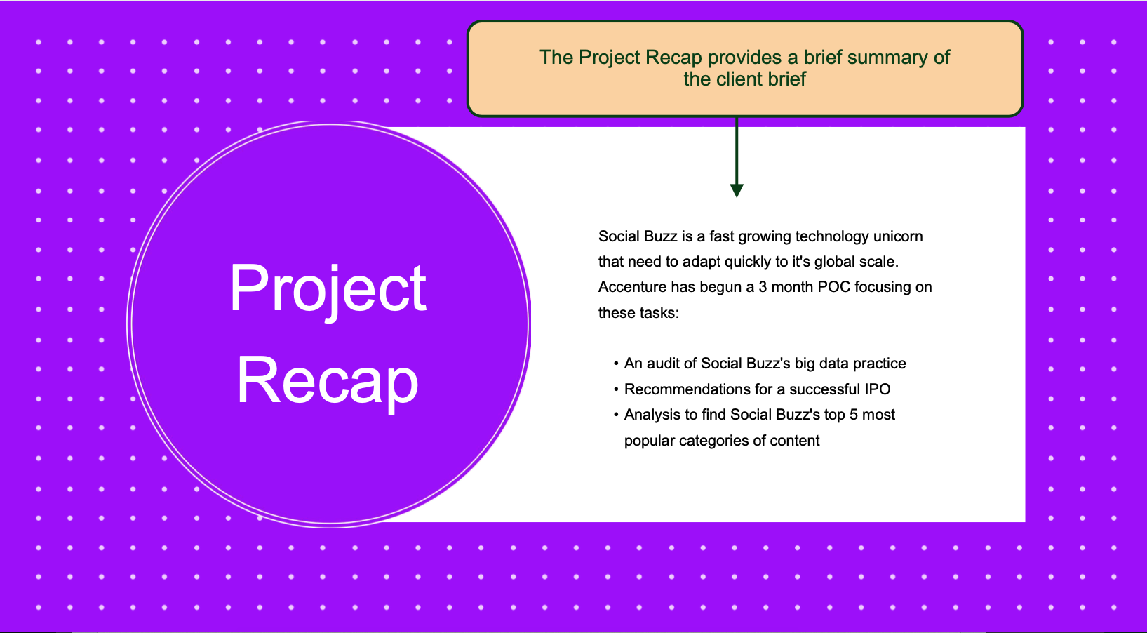

Project Recap

Slide 4
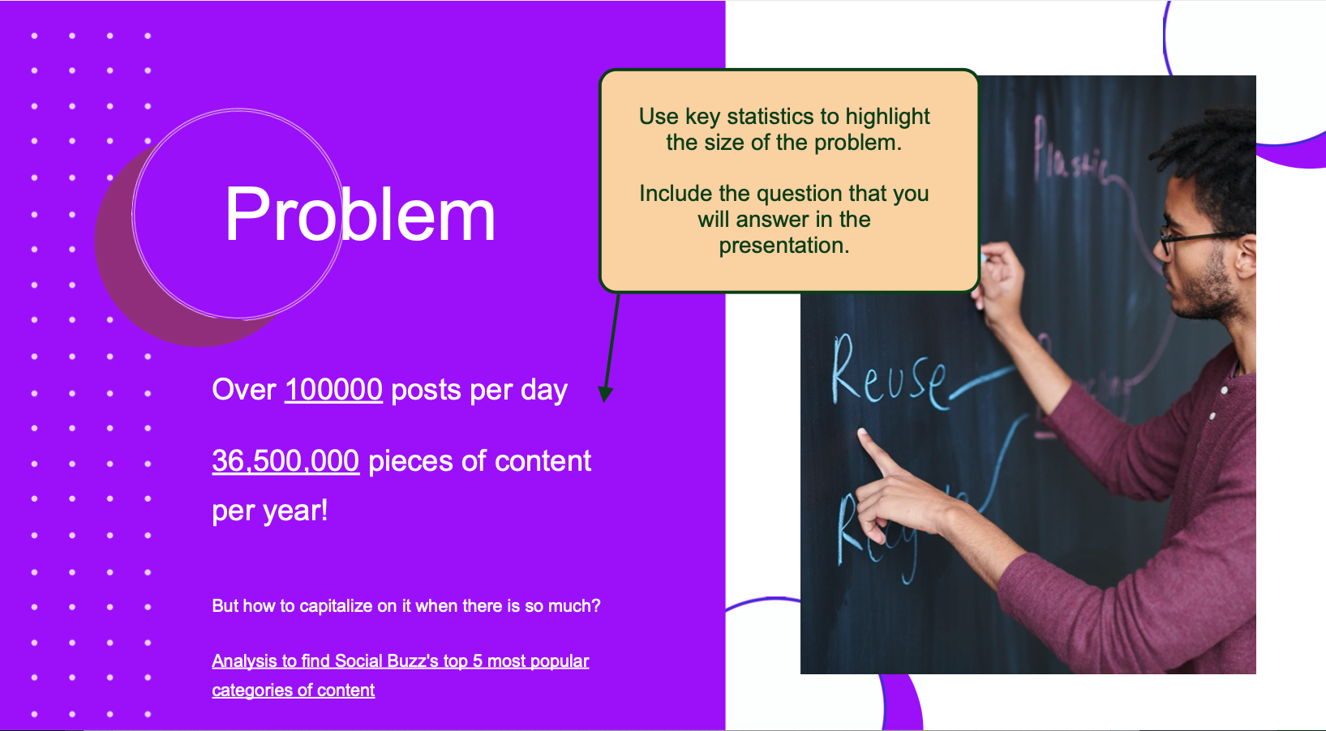

Problem

Slide 5




The Analytics team

Slide 6
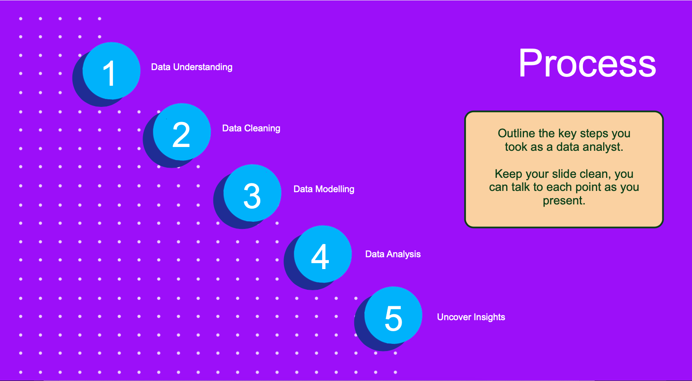
Process
1
2
3
4
5

Slide 7
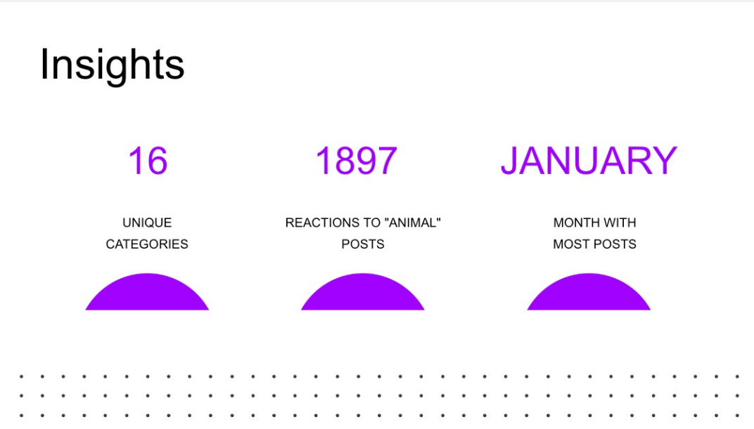

Insights

Slide 8
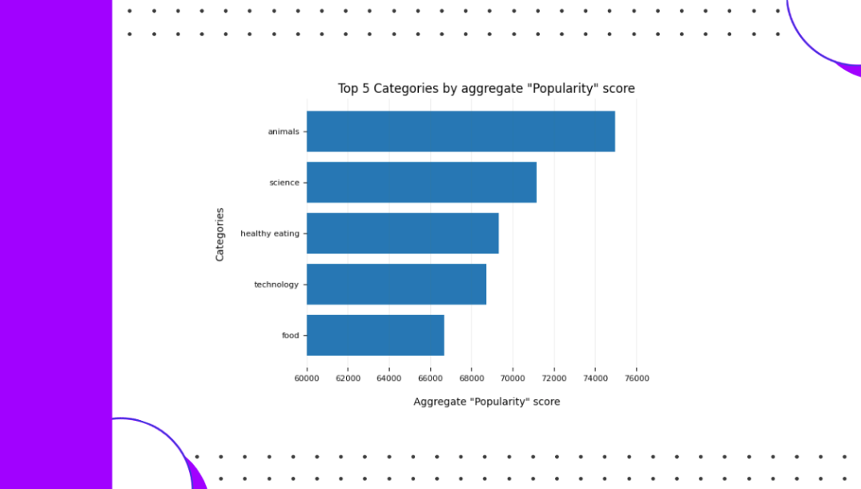

Slide 9
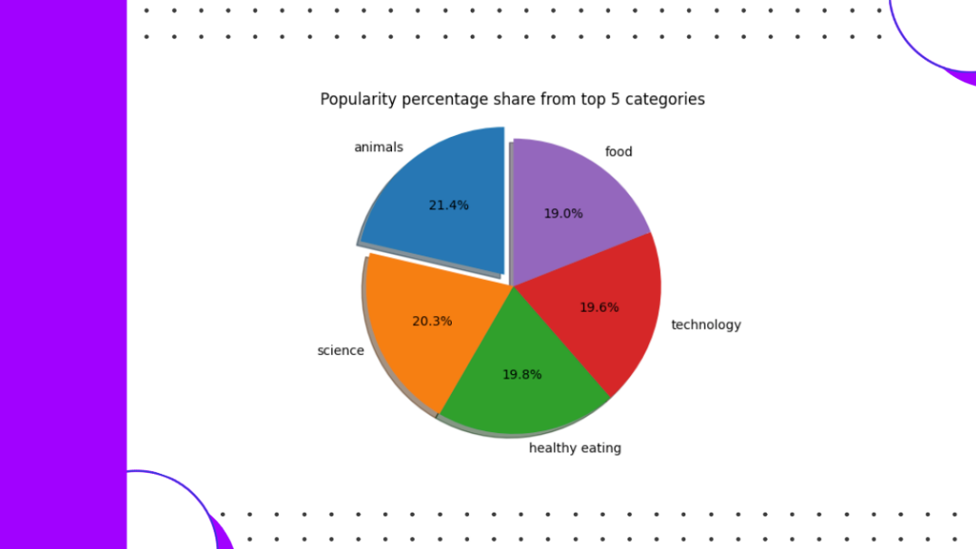

Slide 10


Summary

Slide 11
Thank you!
ANY QUESTIONS?

